Slide 1
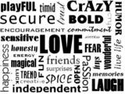
SEMANTICS

Slide 2
Semantics is the study of meaning of words , phrases and sentences. It focuses on what the words conventionally mean , rather than on what the individual speaker might want them to mean on a particular occasion .

Slide 3
Conceptual and associative meaning

Slide 4
Conceptual literal description ( Semantics )

Slide 5
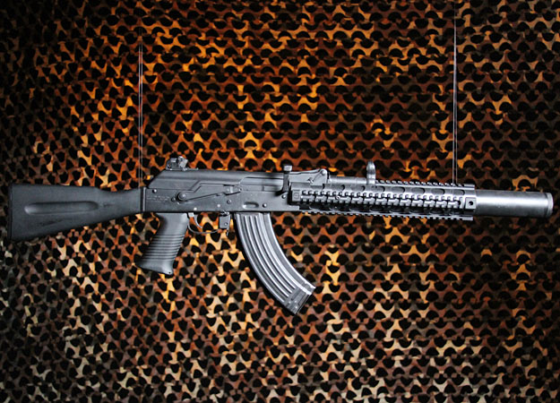
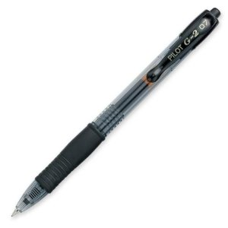

Slide 6
Associative Personal Intended ( Pragmatics )

Slide 7
Water is life itself . Weapon is a curse. Pen is knowledge. ( a cigarette ) A needle means pain but for some cure.

Slide 8
Semantic Features

Slide 9
The television drank my water. His dog writes poetry.

Slide 10
pen man girl horse boy ----------------------------------------------- animate -- + + + + human -- + + -- + female -- -- + -- -- adult -- + -- + --

Slide 11
Semantic Roles

Slide 12
Agent Theme Instrument Experiencer Location Source Goal

Slide 13
Lexical Relations

Slide 14
Synonymy Antonymy Hyponymy Prototypes Homophones and homonyms

Slide 15
polysemy World play Metonymy Collocation

